Slide 1
Leads Scoring Case Study
By – Vijaykumar Rangvani
Shruti Gupta

Slide 2
Problem Statement
X Education sells online courses to industry professionals.
X Education gets a lot of leads, its lead conversion rate is very poor. For example, if, say, they acquire 100 leads in a day, only about 30 of them are converted.
To make this process more efficient, the company wishes to identify the most potential leads, also known as ‘Hot Leads’.
If they successfully identify this set of leads, the lead conversion rate should go up as the sales team will now be focusing more on communicating with the potential leads rather than making calls to everyone.
Business Objective:
X education wants to know most promising leads.
For that they want to build a Model which identifies the hot leads.
Deployment of the model for the future use

Slide 3
Solution Methodology
Stages in making a model
1. Data Gathering
2. Data Cleaning
3. Exploratory Data Analysis
4. Data Preparation
5. Model Building
6. Model Evaluation

Slide 4
EXPLORATORY DATA ANALYSIS

Slide 5
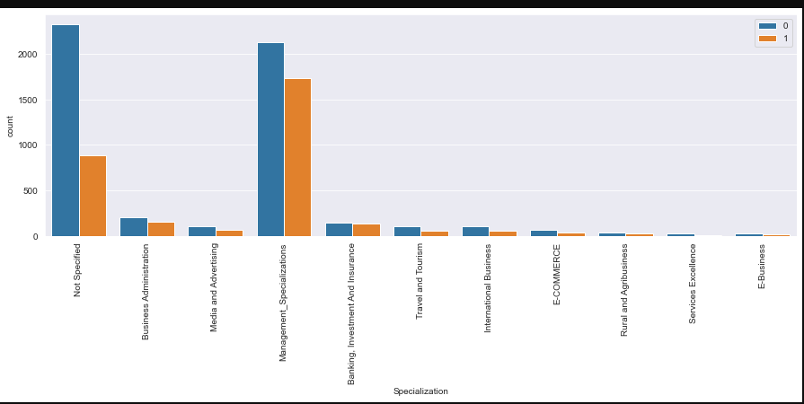
Specialization
Visitors with Specialization in managment generates higher number of leads
Conversion Rate is for Visitors with Specialization in managment skills.

Slide 6
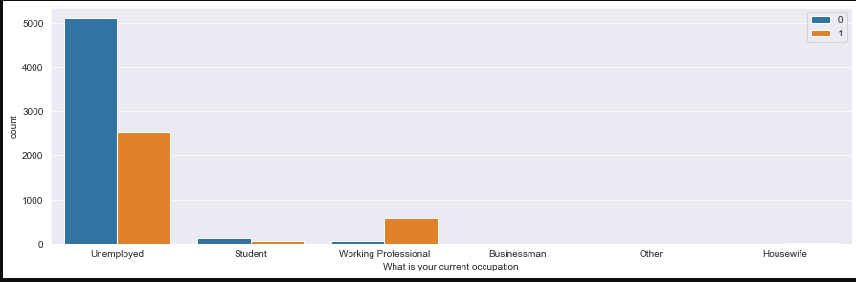
current occupation
Visitors that are umemployed generates higher number of leads
Conversion Rate is good for umemployed as well as for working proessionals

Slide 7
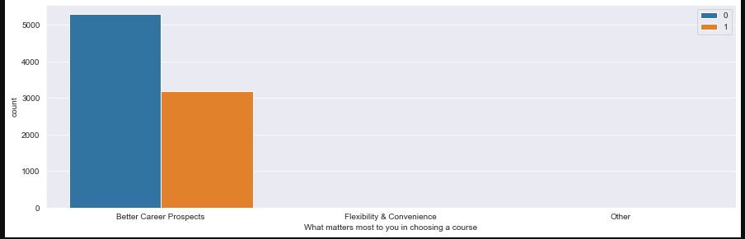
Visitors that have course joining motive as better career generates higher number of leads
- Conversion Rate is also quite for such visitors

Slide 8
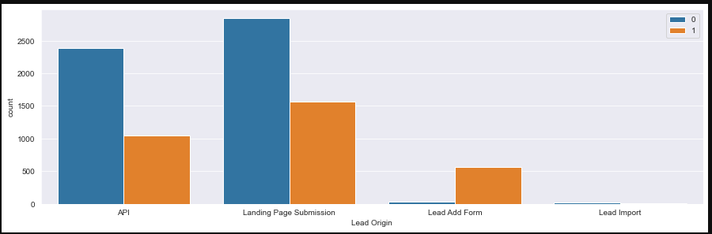
API and Landing Page are major sources for generating higher number of leads
Conversion Rate is also good for both the API and Landing Page
- Conversion Rate is very good for Lead Add form but it is very less in terms of proportion

Slide 9
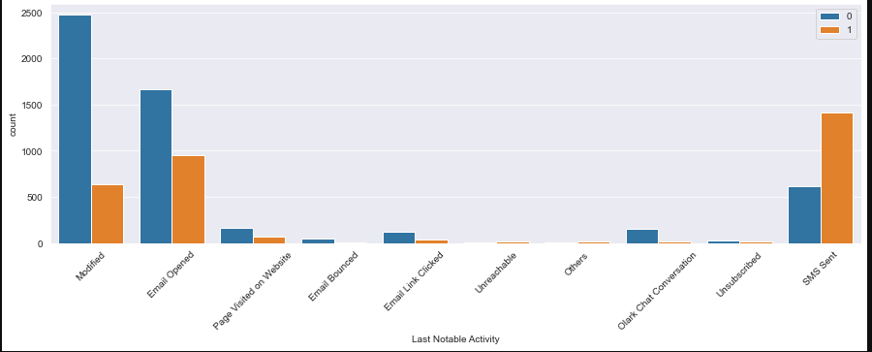
Visitors with Last Activity status as modified, opening email, SMS Sent brings higher number of leads as compared to others
- Conversion Rate is best for SMS Sent category visitors among the mentioned three activities

Slide 10
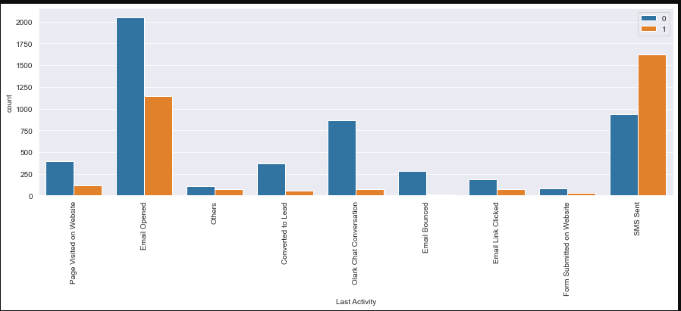
Email,SMS and chat conversion activities helps to produce higher number of leads
Conversion Rate is best for SMS and Email conversion
- Conversion Rate can be improved for visitors that engage in Chat conversion.

Slide 11
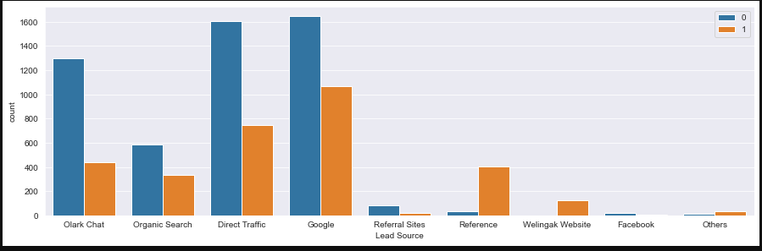
- Google and Direct Traffic generates higher number of leads
- Conversion Rate is also quite for Google and Direct Traffic generated leads.
- Reference and website as lead source are less in proportion but has good conversion rate

Slide 12
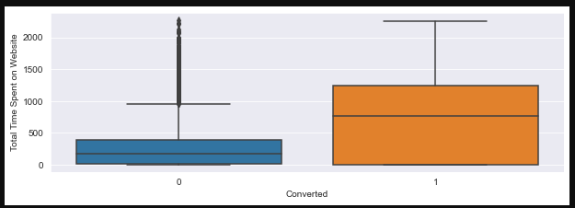
Conversion rate is higher for users with more time spent on website
- Enganging UI can be developed for Website so that users spend more time.

Slide 13
Conclusion

Slide 14
Conclusion
It was found that the variables that mattered the most in the potential buyers are (In descending order) :
The total time spend on the Website.
Total number of visits.
When the lead source was:
a. Google
b. Direct traffic
c. Organic search
d. Welingak website
When the last activity was:
a. SMS
b. Olark chat conversation
When the lead origin is Lead add format.
When their current occupation is as a working professional.
Keeping these in consideration the X Education can increase the business

Slide 15
Thank You

